Slide 1
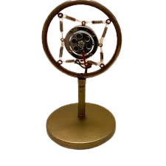


Podcasting
Interview with a Historical Icon
Lesson 1: Script Writing

Slide 2
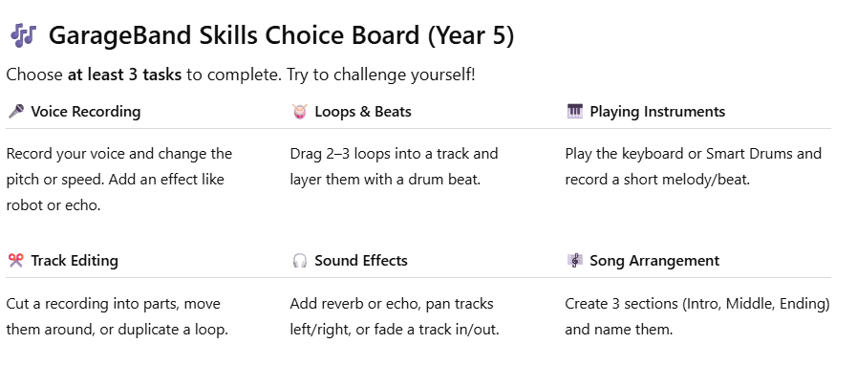
10min Skills builder Challenge

Slide 3

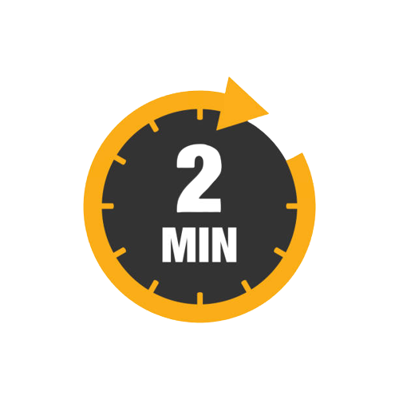
Think pair share
What do you know about podcasts?

Slide 4
Your assignment is to….
In pairs, you need to plan, script, record and edit a 2 minute podcast episode interviewing a person from history.

Slide 5
Learning objectives
I can record my ideas using cloud based software
I can collaborate with my friend
I can use software to create and present digital content for a digital podcast.

Slide 6


A dive through time
Notes:
Play the children the example or deploy via google classroom to listen to

Slide 7
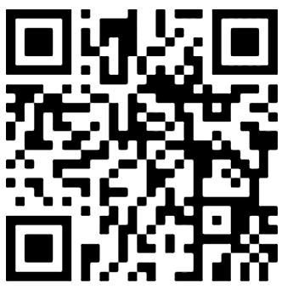
Describe who they are
Where do they come from (place?)
Who inspired or supported them?
What will your podcast discuss?
What were their main achievements?
What makes them unique?
What challenges did they overcome?
Why did they do the things they did?
Notes:
Encourage the children to think about the historian or person from person from that time period’s point of view.
*The 5 W (Who are they? What do they do? Where do they come from? When in time are they from? Why are they talking on the podcast?
* What is life like? Food, housing, celebrations
*What did they do for work, did they enjoy it?
*

Slide 8
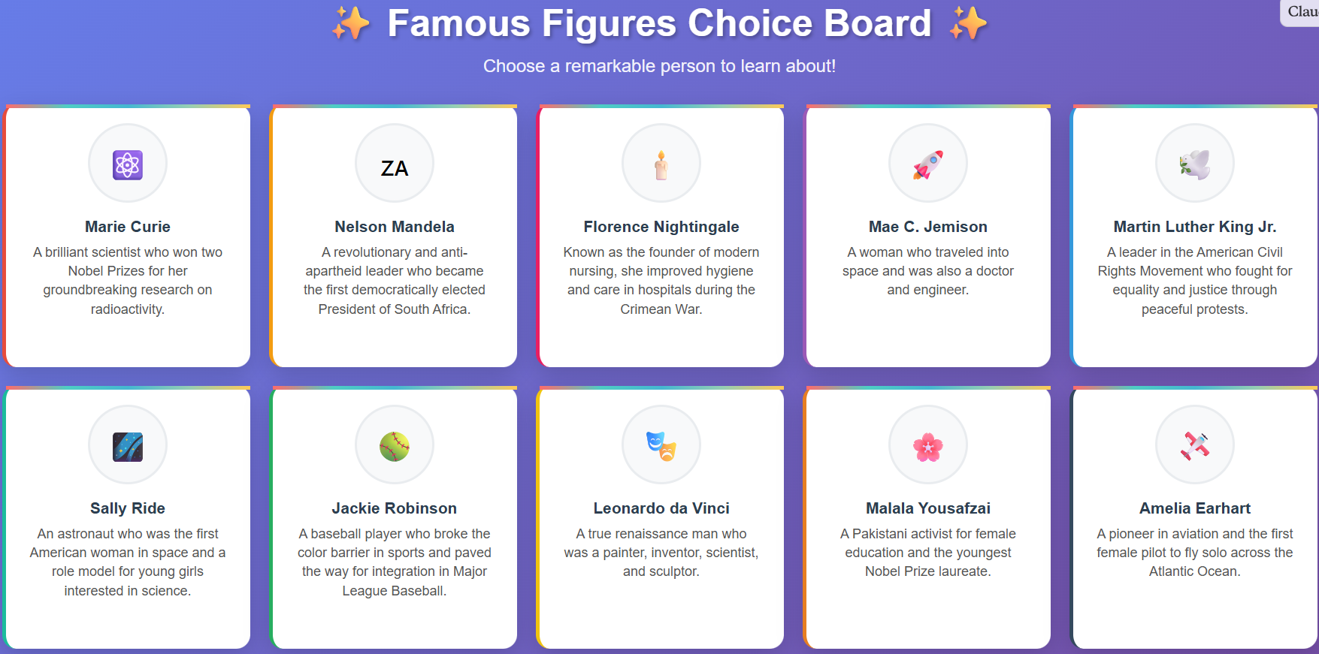

Slide 9
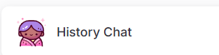
Have a chat with your famous person
Talk with your famous person from history using the AI character bot. Ask them the question will ask in your podcast and record their answers in your script
Notes:
Magic School student link: https://student.magicschool.ai/s/join?joinCode=ZEgLiQ

Slide 10

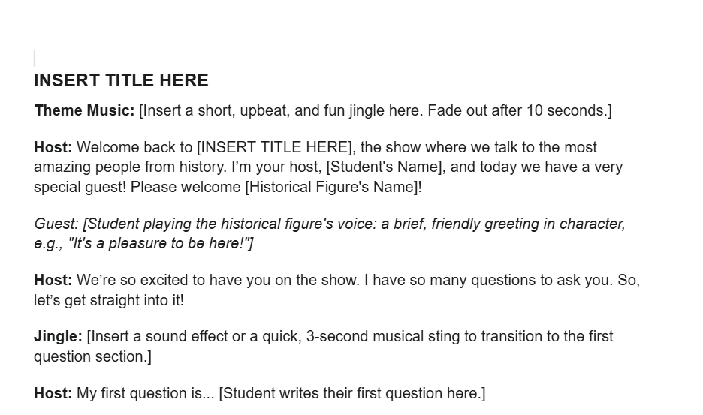
Editing your script
Add your questions and answers from the chat bot to the example script.
Edit the script to make it interesting and unique
Think about:
Sponsors for the show
Mini advert breaks etc
Notes:
Deploy script via G-Classroom
https://docs.google.com/document/d/19uKkQyS35jbtVGb4vCQLpg7SrzaX1Ur6TNbFKK46C58/edit?usp=sharing
Or Convert to notes and Air drop ask AW for notes template

Slide 11

Podcasting
Interview with a historian
Lesson 2: Recording

Slide 12
Learning objectives
I can collaborate effectively
I can use software to capture and manipulate audio
I can use software to edit and modify project

Slide 13
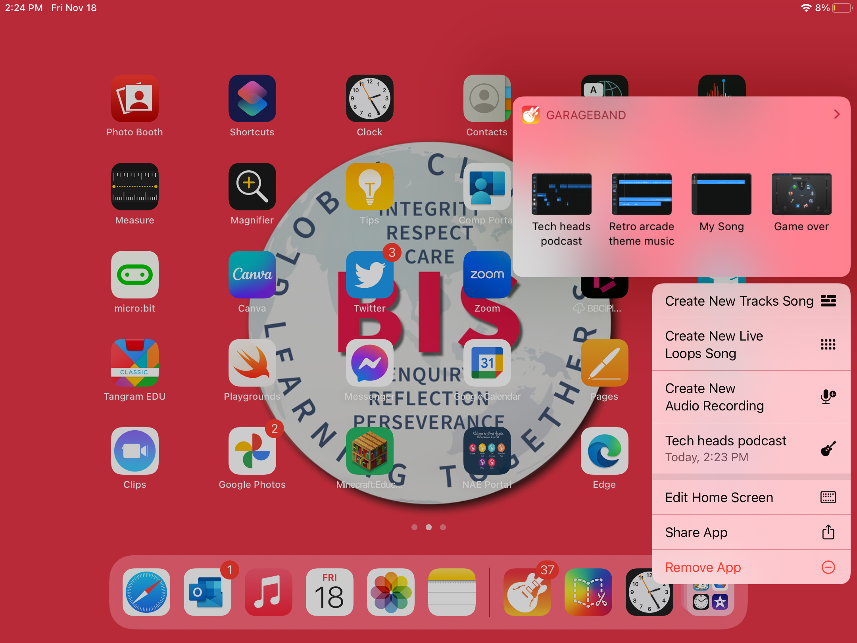
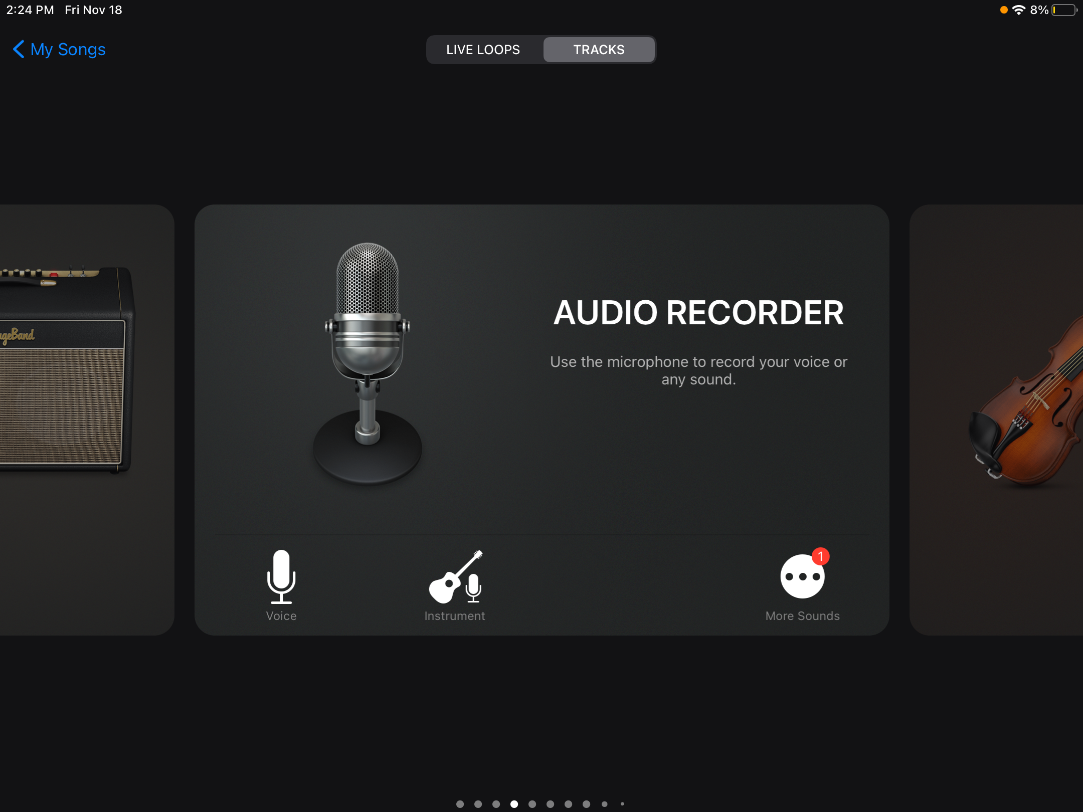
Time to record !
Practise your script by doing a table read of your material
Tap & hold on top of the Garage Band Icon
Press ‘Create new Audio Recording’

Slide 14
Recording essentials !
Use one ipad for garageband and another for your script
Do NOT record your podcast in one go- complete it in chunks
Listen to your recording and check it is good. Do this every time!
Turn off the metronome
Do NOT move the ipad when recording
You must RENAME the project with BOTH people AND class

Slide 15
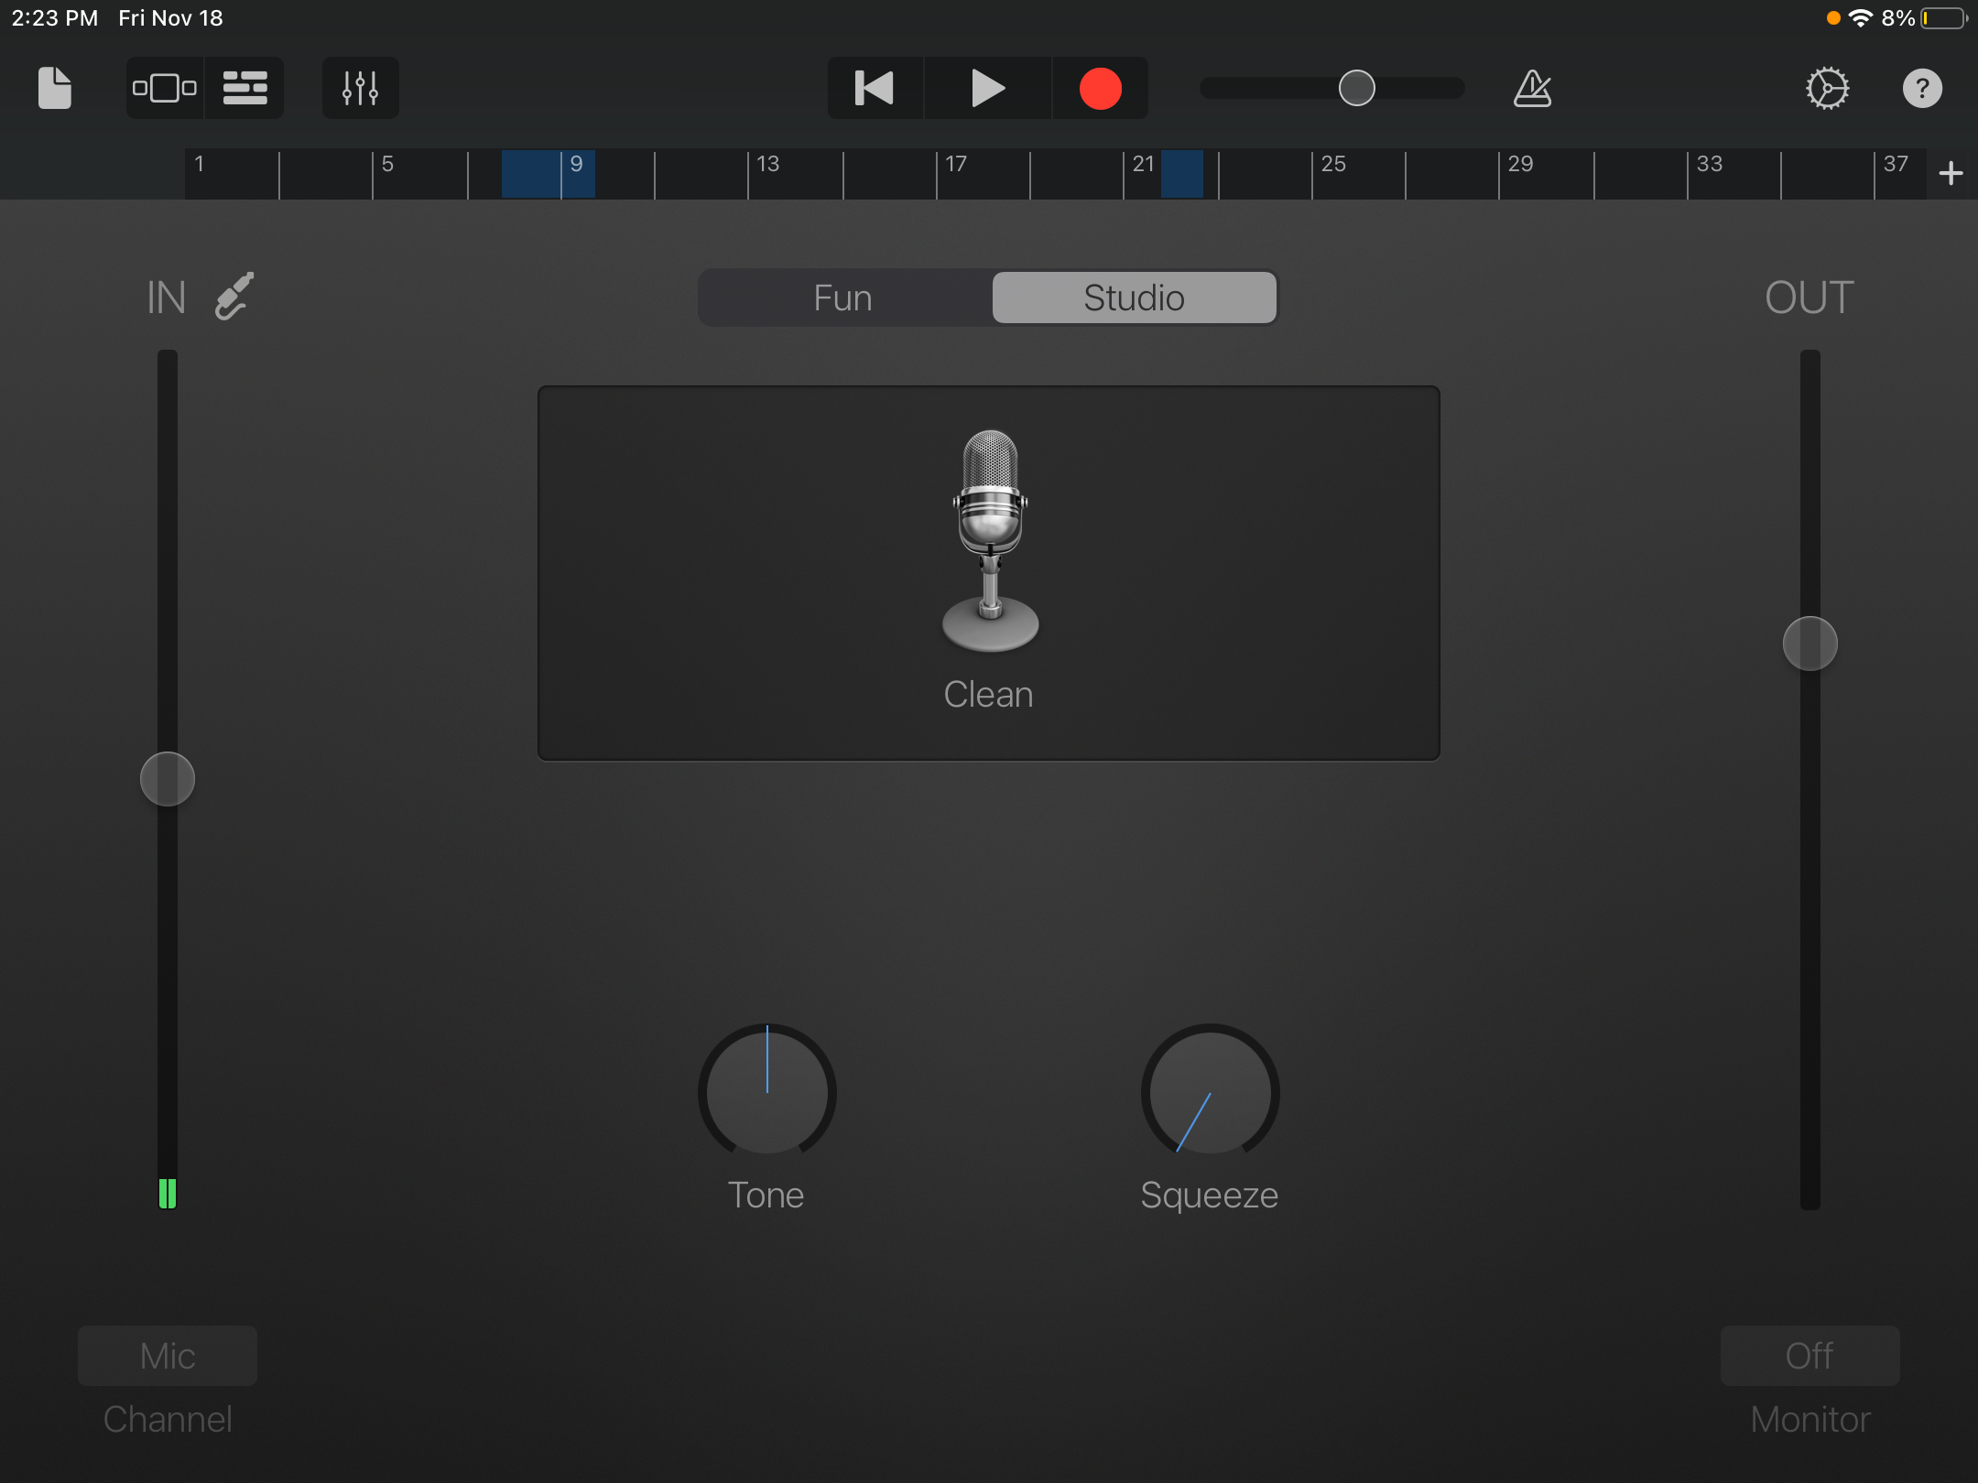
2. Press record and stop to finish.
3. Switch to track view to trim, edit or delete the recording.
Check the bars are set to automatic.
Turn metronome off

Slide 16
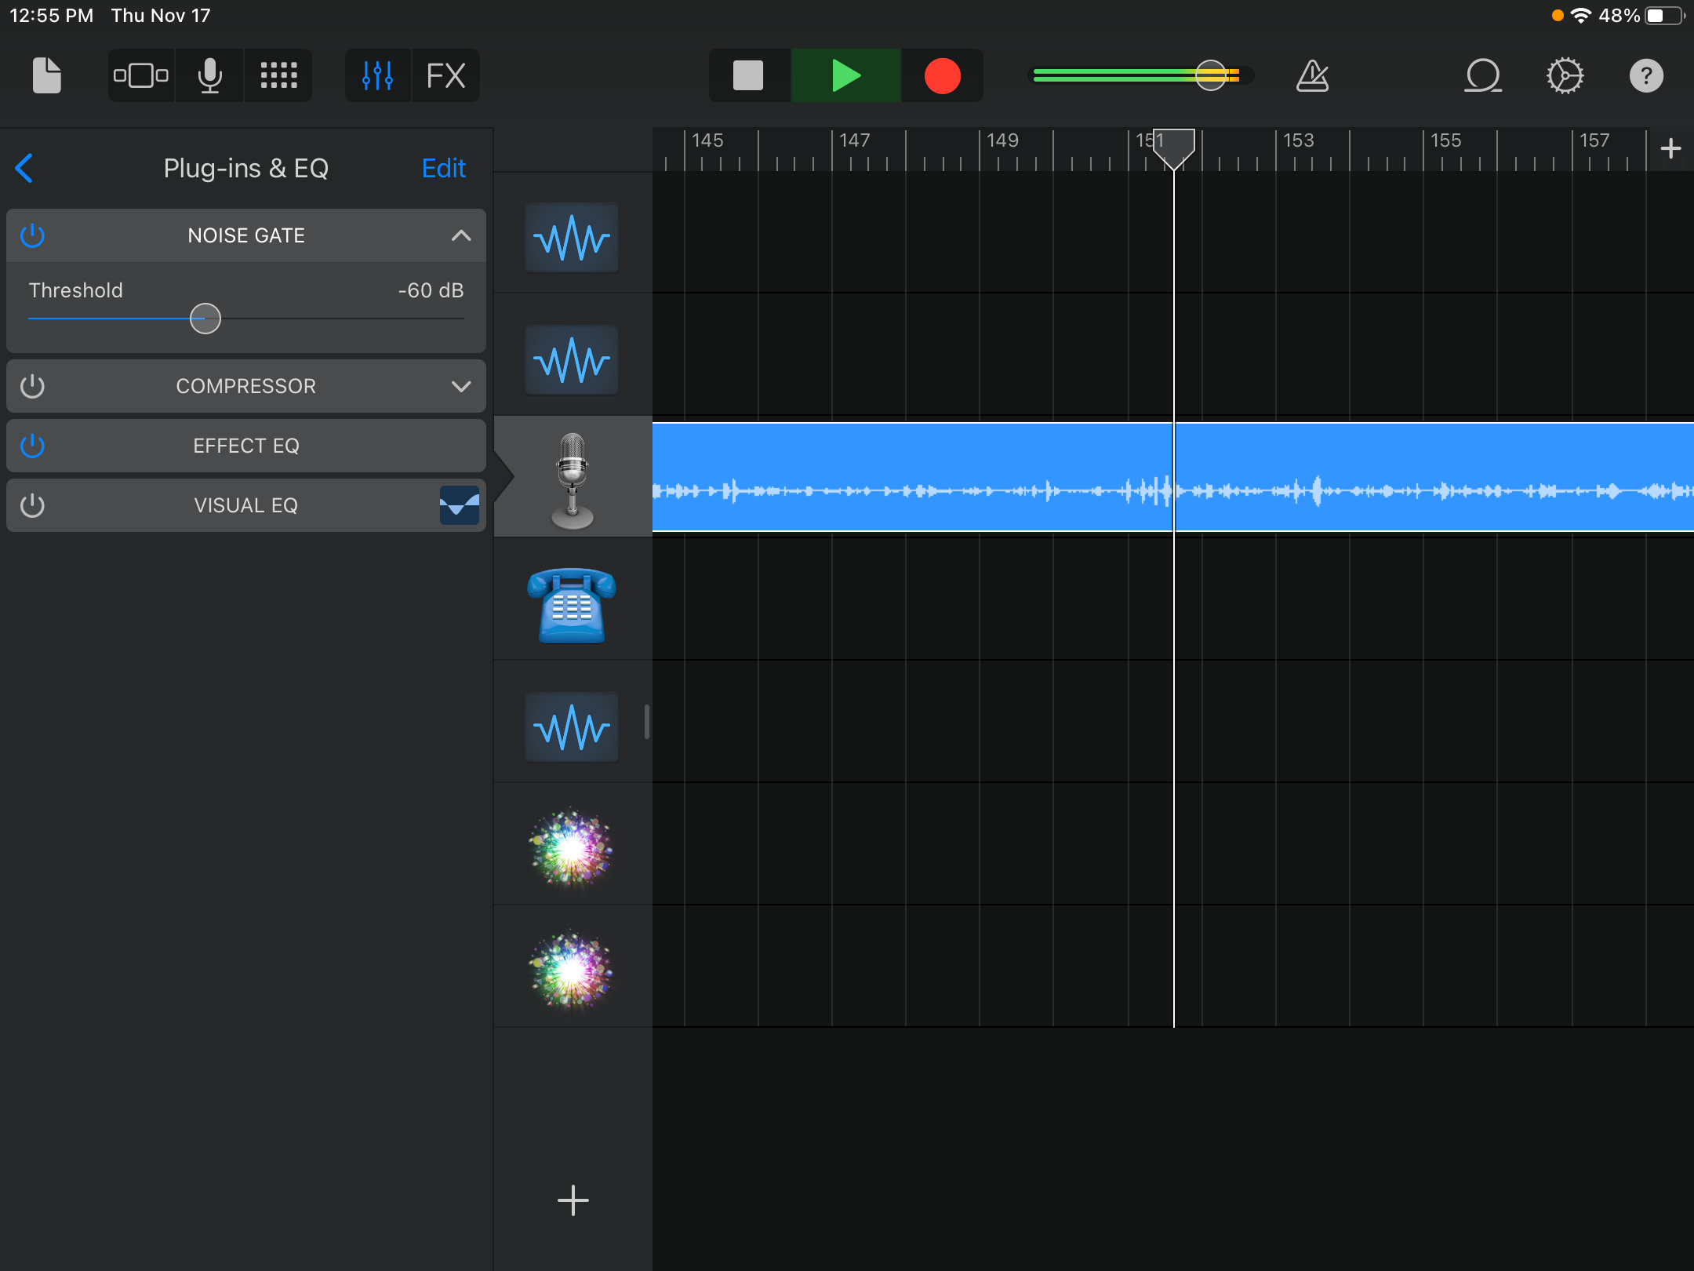
In track view, press sliders icon.
Move the noise gate slider to reduce background noises.

Slide 17

Podcasting
Interview with a historian
Lesson 3: Post production
Notes:
This lesson focuses on the keys skills of splitting audio and manipulating to fit the timeline
Creating a jingle

Slide 18
Learning objectives
I can collaborate effectively
I can use live loops, add instruments and layer tracks
I can use software to edit and manipulate audio for a audience or purpose.

Slide 19
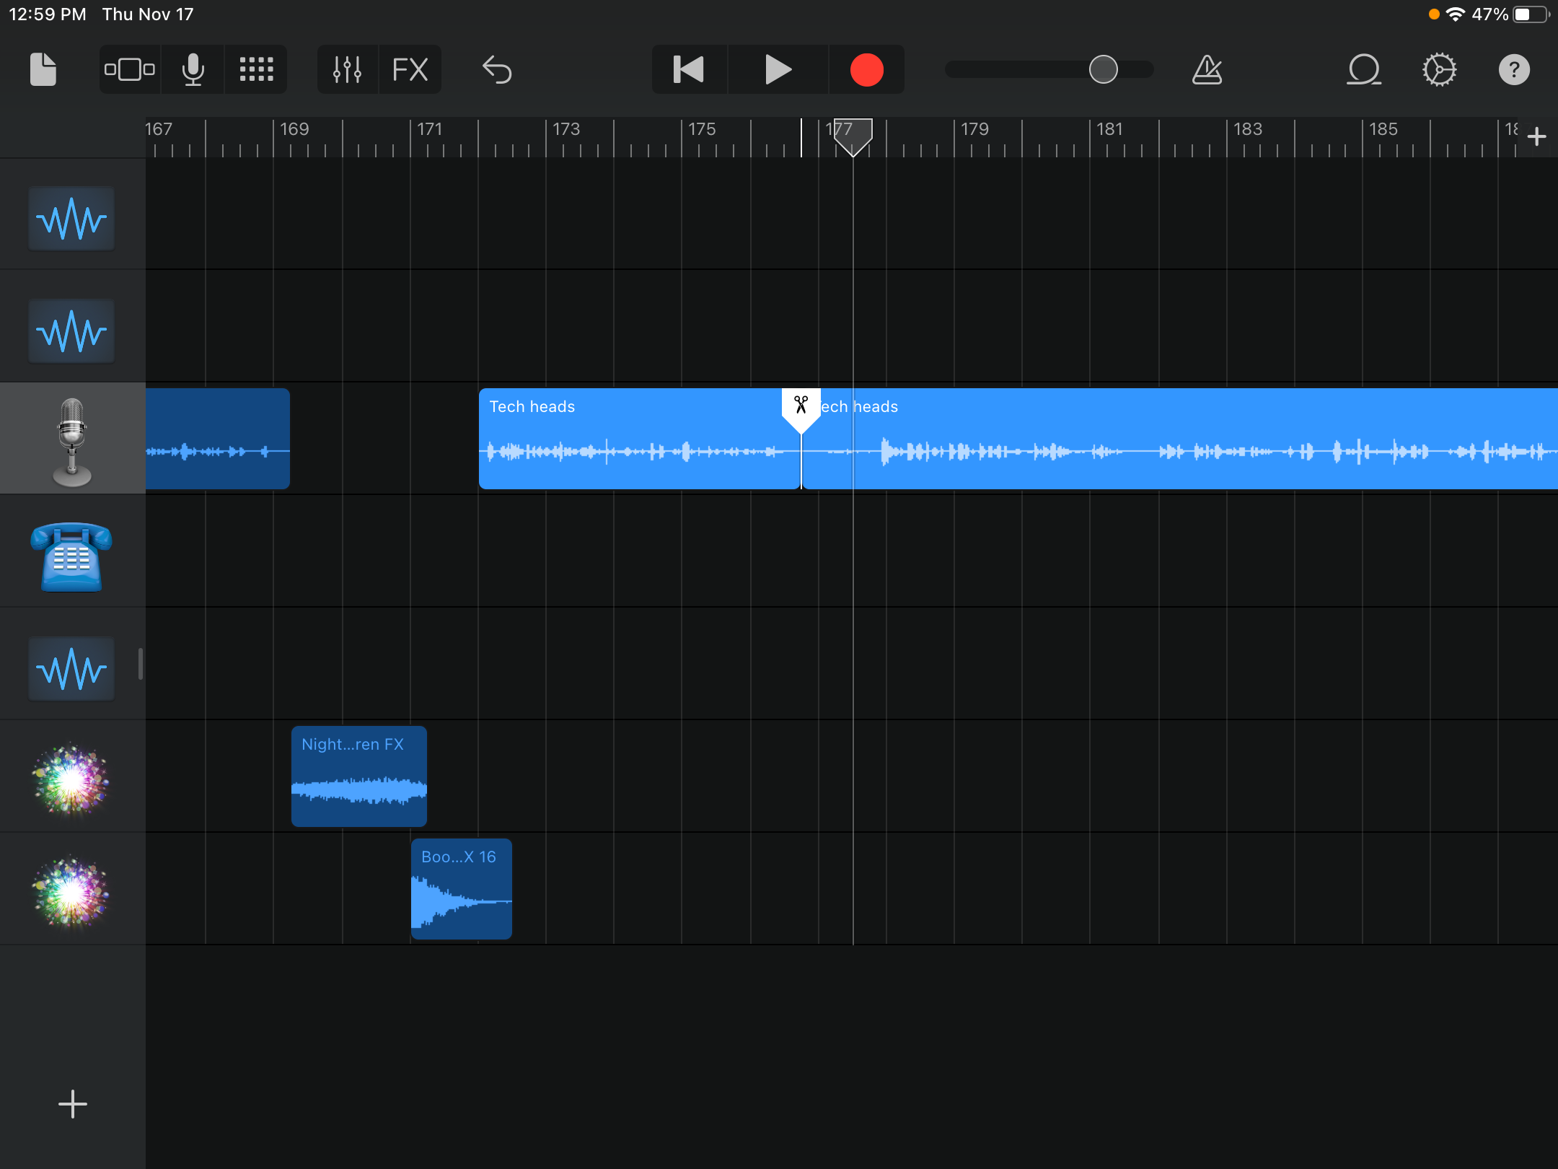
In track view, tap and hold on top of your audio recording.
Select split. The. Drag the scissors down to split the recording.
Move the different parts to a new track or delete if unwanted.

Slide 20
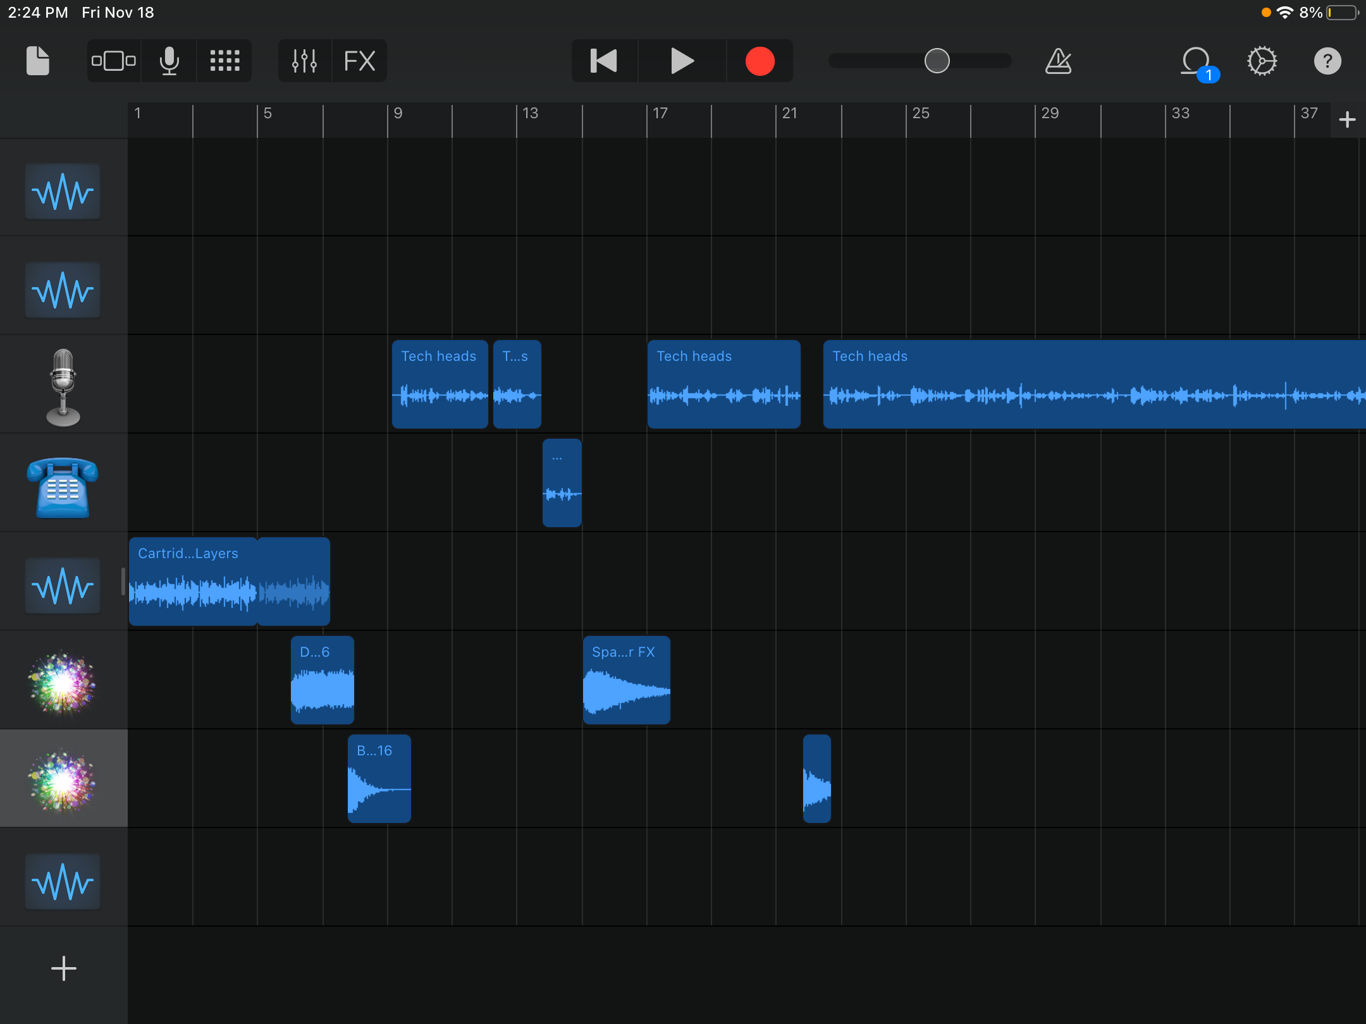
Tap and hold on a track.
Press duplicate to add other sound FX
Move the different segments onto the timeline so that it plays without any gaps.

Slide 21
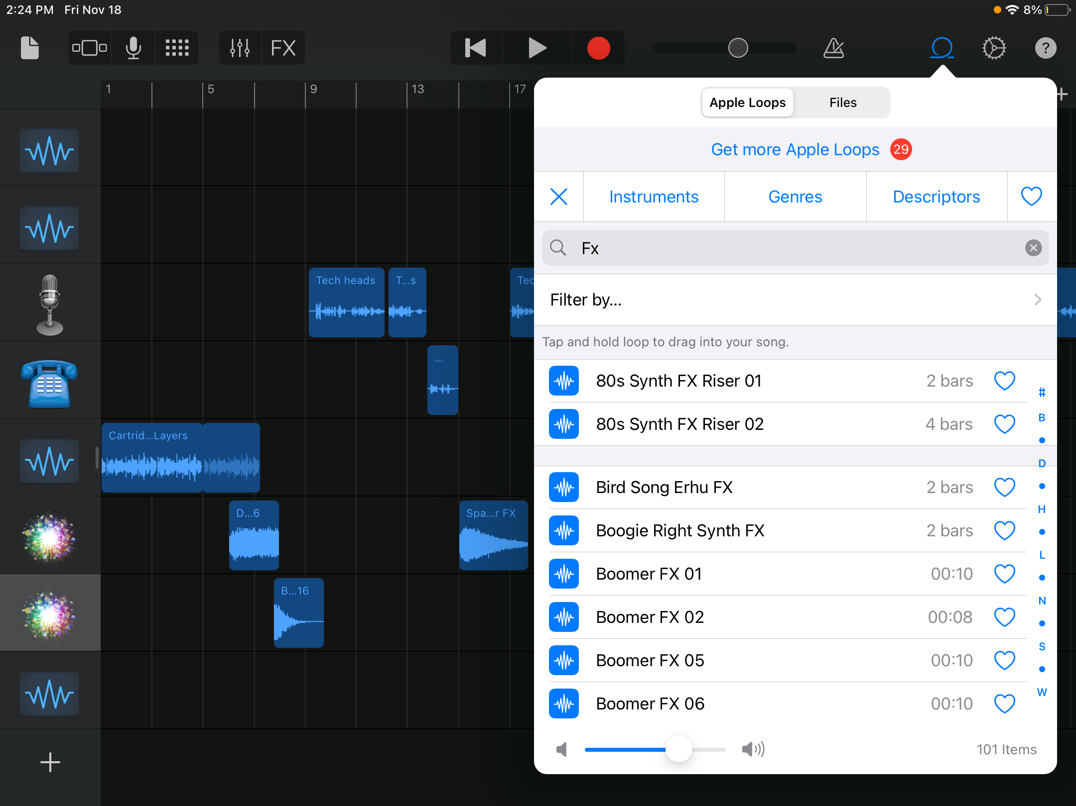
Press live loops and search for ‘FX’ and listen to different sound effects.
Drag the sound FX onto a gap on the timeline.
Notes:
Make a list on WB for any good live loops or FX the children could use for this project

Slide 22
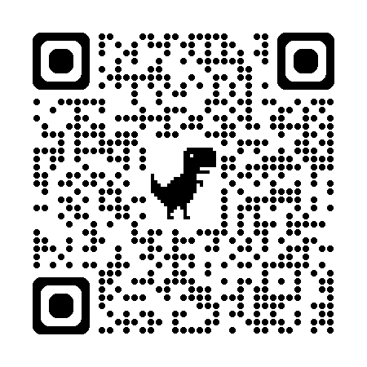
Alternative music method: Downloading royalty free music
Using Pixabay search for Podcasting music
Download the music file (MP3)
Import the music to Garageband using file browser in live loops

Slide 23
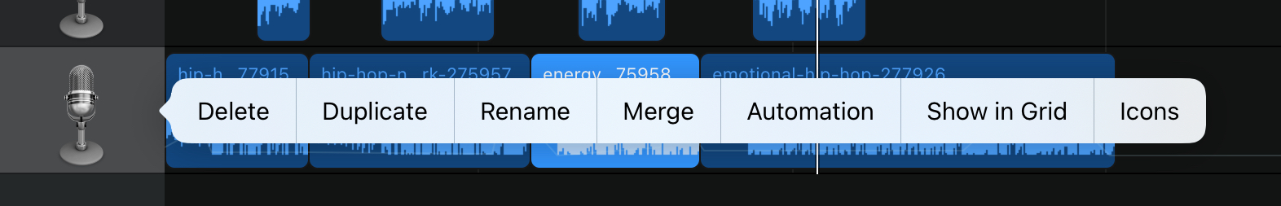
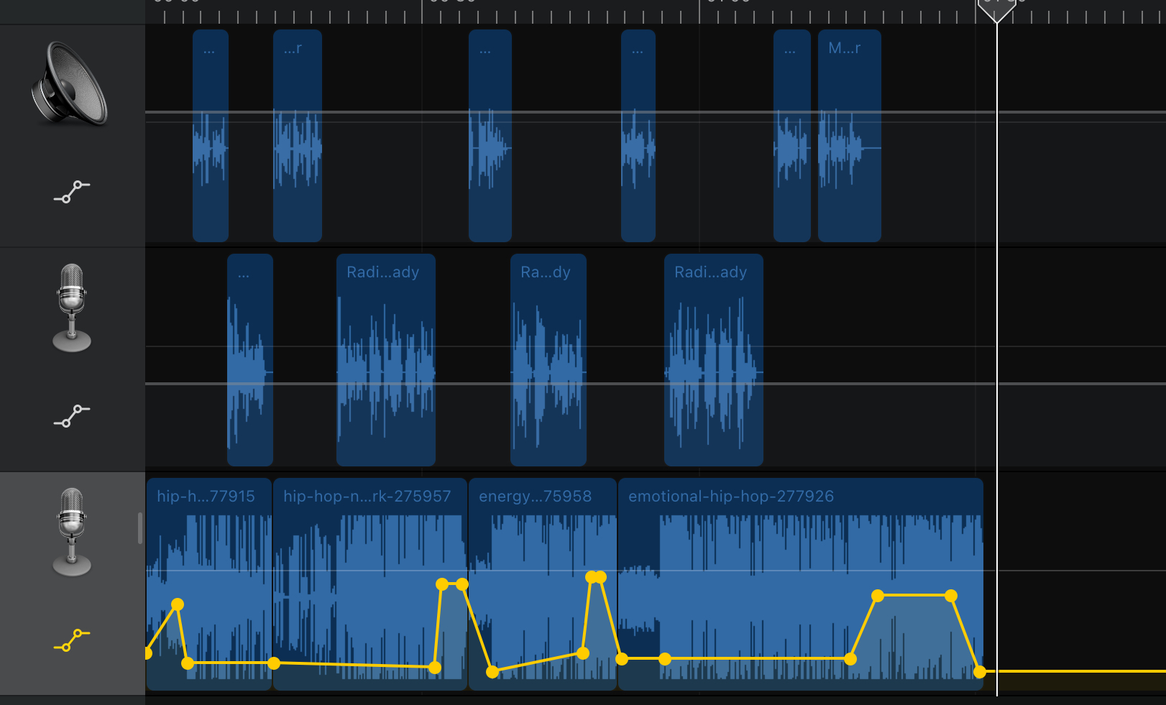
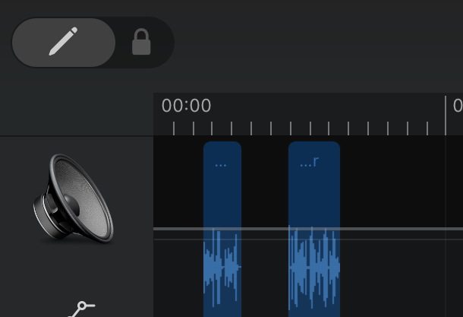
Applying Automation to Your music -
Notes:
Automatically changing volume of your music so can hear Audio clearly
Add Markers/points to turn volume up or down where there is spoken word. Can be deleted or click undo to remove point

Slide 24
Simple steps to success
Turn off the metronome
Record all your questions and answers first
Record audio on different tracks
Add your music and automation last on a new track

Slide 25

Podcast Checklist
Theme music made from live loops
Introduce podcast name and outline the theme for the episode
Music link between segments
Main topic clearly and confidently discussed
Introduce guest speaker
Host interviews guest speaker
Outroduction
Notes:
Discuss the success criteria for the project and this can be displayed throughout the sequence of teaching

Slide 26
Todays Checklist
Add your music and automation
Listen back and edit.
Share your project as a SONG to YOUR OWN iPad using airdrop
Create cover art on Canva
Upload everything to Seesaw
Complete Google Form AND Quiz on Google Classroom
Listen to your friends work and leave Quality feedback
Notes:
Discuss the success criteria for the project and this can be displayed throughout the sequence of teaching

Slide 27

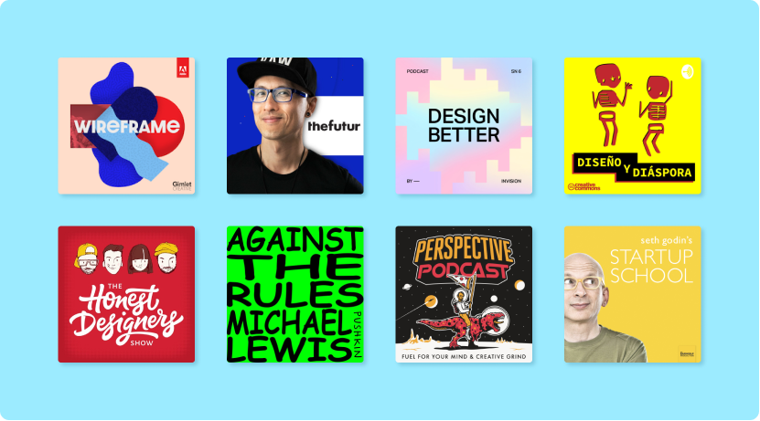
Make your own Podcast cover art?
Search for Podcast cover art template and edit it.
Notes:
Find and edit a template for their work.

Slide 28

Podcasting
Interview with a historian
Lesson 4: Evaluation

Slide 29
Learning objectives
I can use convert file types and export to a range of software
I can use cloud based software to share my work
I can give critical and constructive feedback to others
I can understand feedback given and improve my work

Slide 30

How to share your work
Method
Create a screen recording, with audio, of your podcast in track-view and upload this movie to Seesaw.

Slide 31
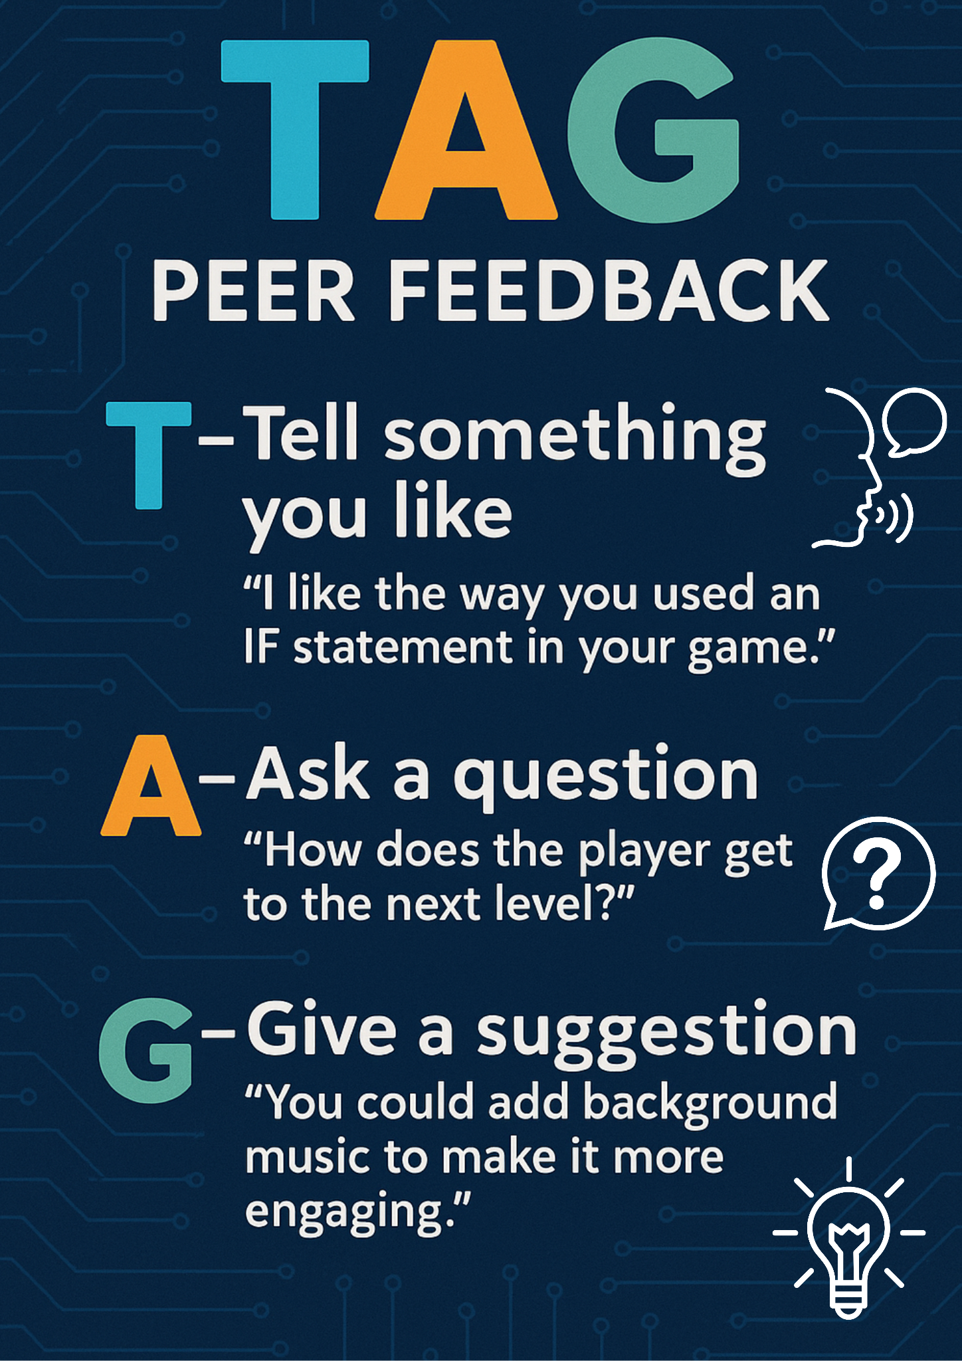
TAG Feedback on Seesaw
Listen to a friends podcast and give them some TAG feedback!
Notes:
https://app.seesaw.me/pages/shared_activity?prompt_id=prompt.f4cfcd99-e83e-41c7-94ea-8f3240648c8a&share_token=ht5F9pOuTjisfObCAJz3iQ

Slide 32
Audio production: Garage band
In this project the students created their own interview podcast with someone from the past. They used skills, knowledge and tools such as: generative AI, audio capture, manipulation and editing, audio loops and automation. Fantastic effort Year 5!

